Slide 1
SEMANTIC TABLEAUX
Individual Homework – Cantor Alexandru-Horatiu

Slide 2
THEORY ASPECTS

Slide 3
Semantic Tableaux Method
It was proposed as a proof method for classical logics by
R. Smullyan in 1968.
Dedicated theorem provers: 3TAP, pTAP, leanTAP, Cassandra.
It was easily adapted to nonstandard logics (modal, temporal, many-valued, non-monotonic).
It is based on semantic considerations => semantic method.
Its basic aim is to decide consistency and to find all the models of a formula by decomposing the formula in subformulas.
The validity of a formula is proved by contradiction=>
=> refutation method.

Slide 4
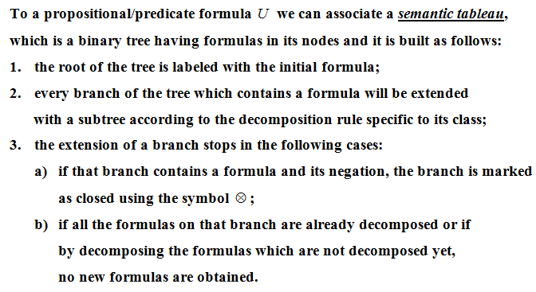
Construction of a semantic tableau

Slide 5
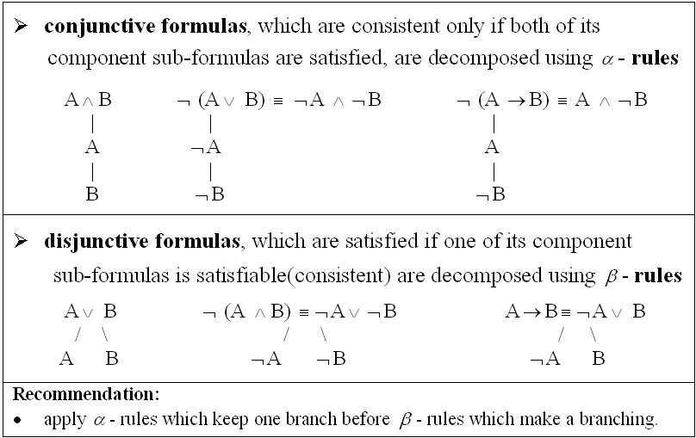
Decomposition rules for formulas

Slide 6
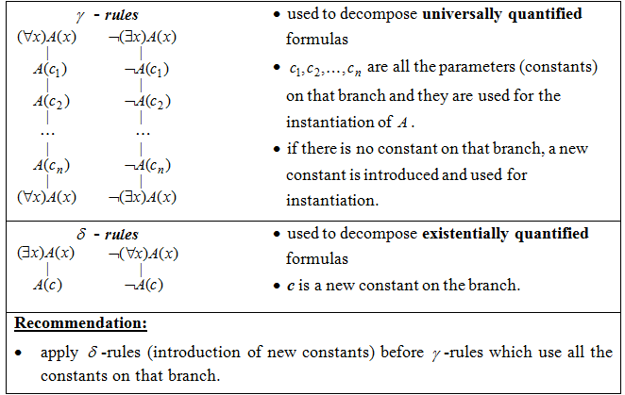

Slide 7
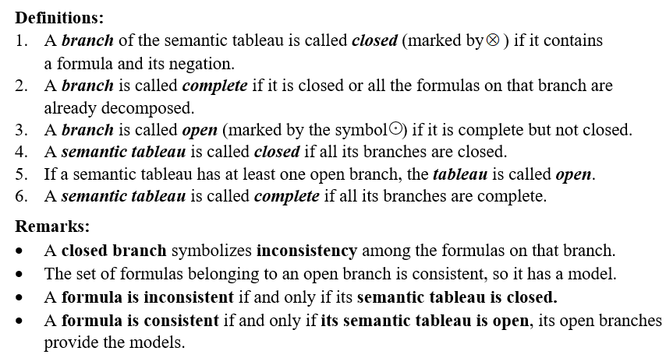
Definitions

Slide 8
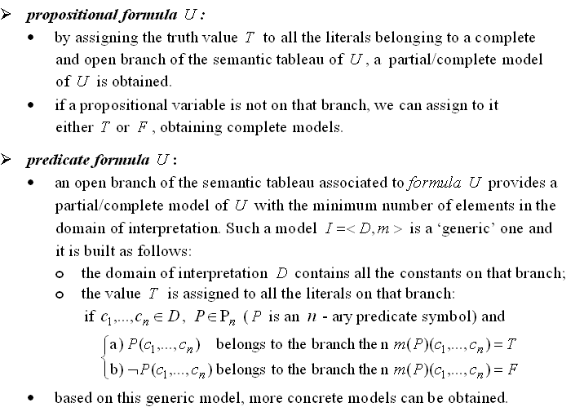
Models of a formula

Slide 9
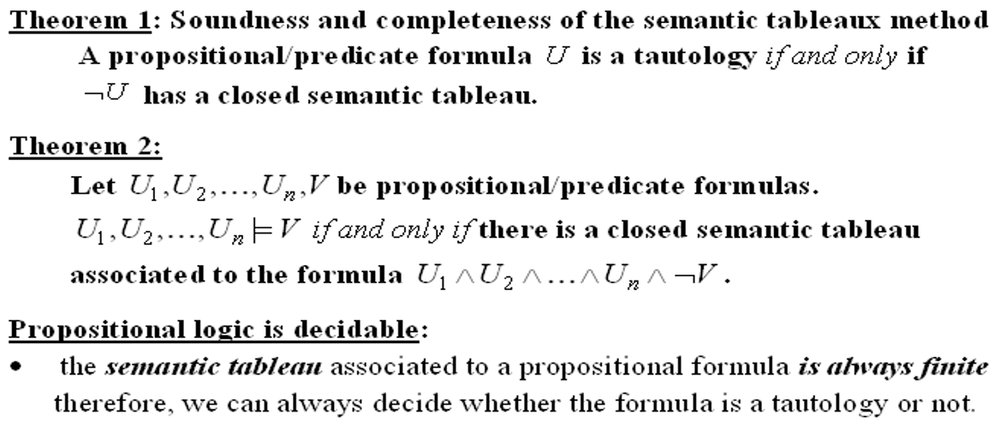
Theorems Semantic tableaux method – a refutation proof method

Slide 10
Solution
of problem statement 5.1

Slide 11
Problem statement:

Slide 13
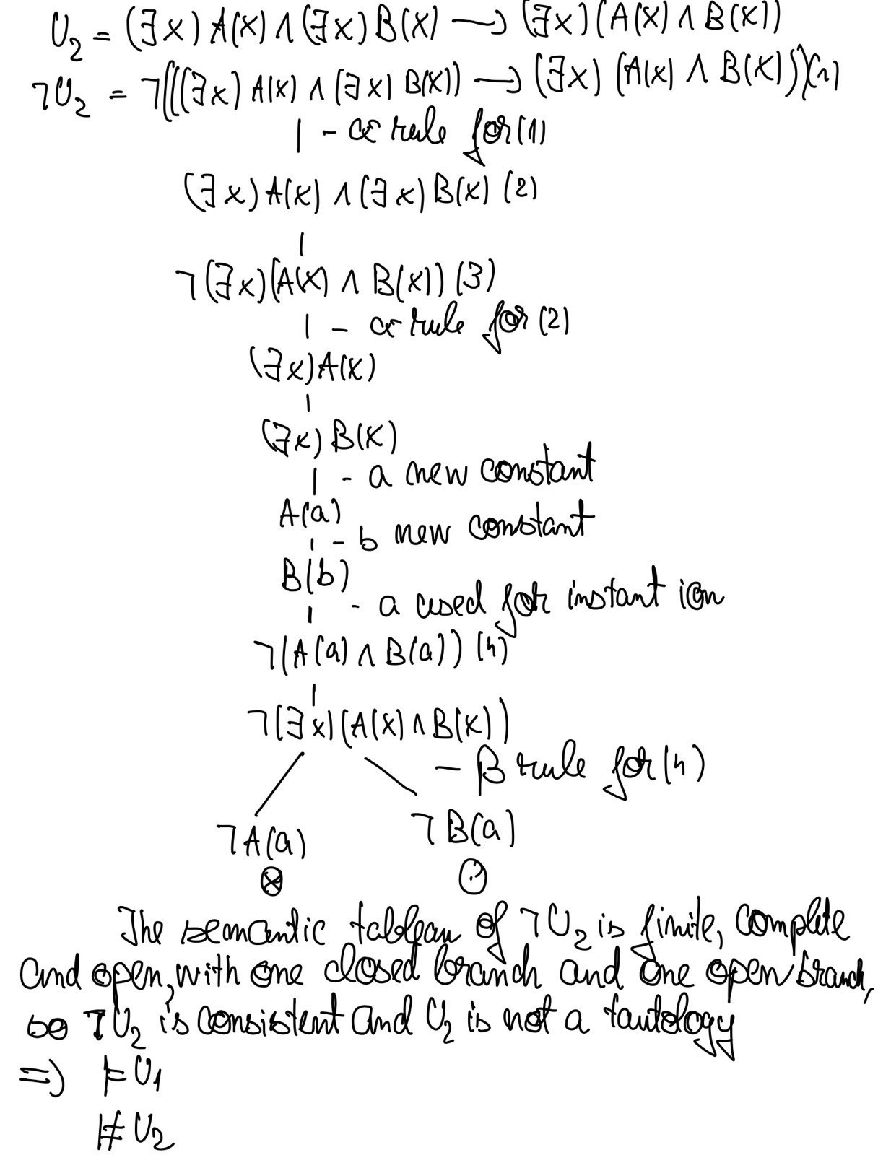

Slide 14
Conclusion:
’ ’ is semi-distributive over ’ ’:

